Slide 1
Automatic Center of Rotation adjustment in synchrotron XCT
08/10/2023
Garima Dhakal

Slide 2
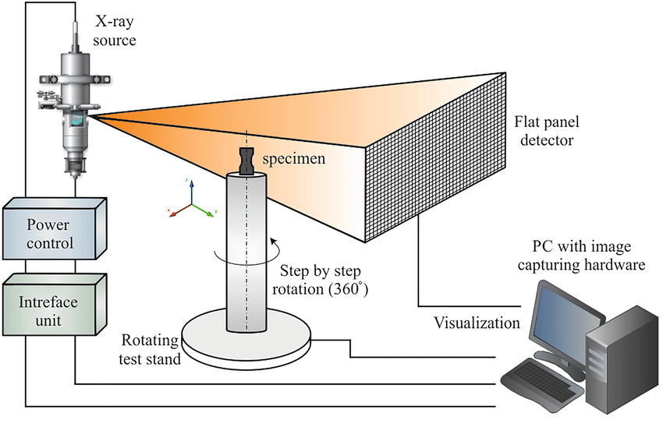
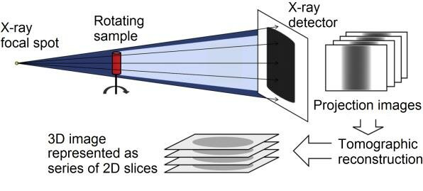
Background

Slide 3
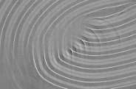

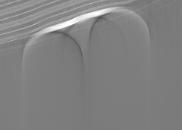
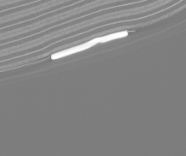
Center of Rotation (COR)

Slide 4
Introduction
Prone to Error
Problem with Manual COR Finding
Time Consuming
Normal Distribution of Random COR
Reconstructing Specific Slice for all COR
Calculation of Standard Deviation
Plotting the COR Values to SD
Procedures
Analyzing the Trend

Slide 5
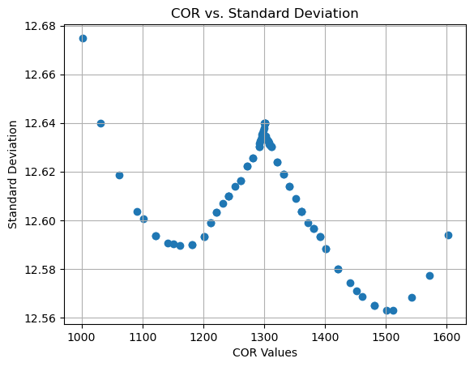
Standard Deviation VS COR
Normal Distribution of Random COR
Reconstructing Specific Slice for all COR
Calculation of Standard Deviation
Procedures
Plotting the COR Values to SD
Analyzing the Trend
C200
2_230110_1200_00001

Slide 6
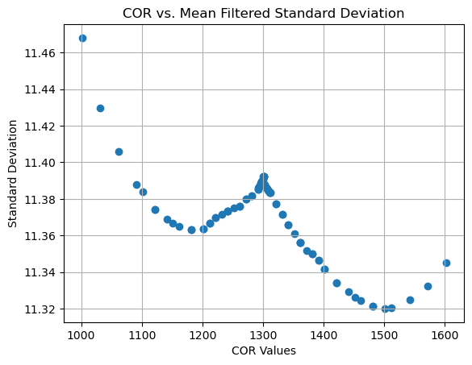
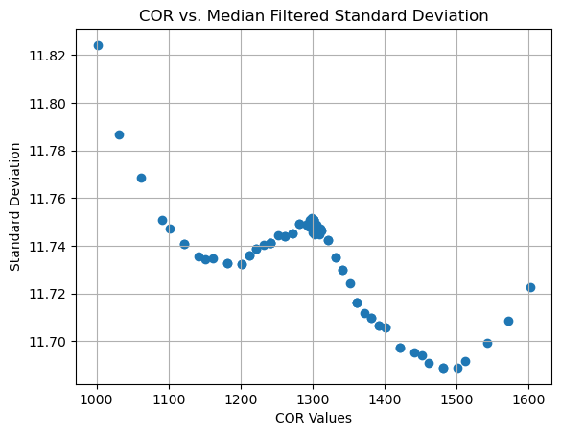
Standard Deviation
Reconstruction
Reconstruction
Reconstruction
No Filter
Mean Filter
Median Filter
Standard Deviation
Standard Deviation
Standard Deviation

Slide 7
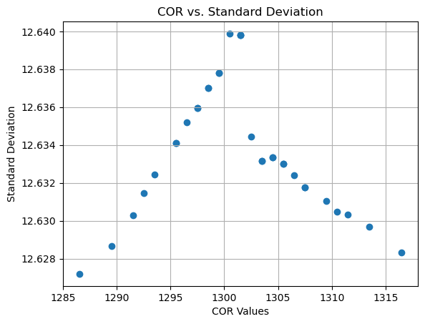
Analyzing the Curve

Slide 8
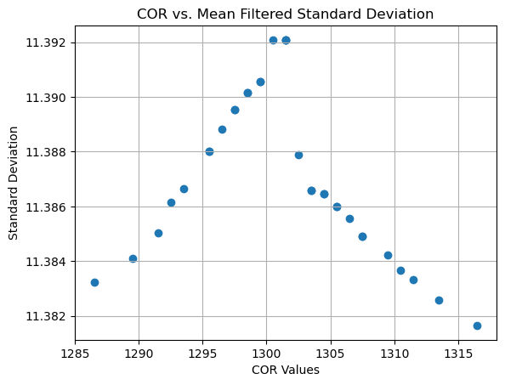
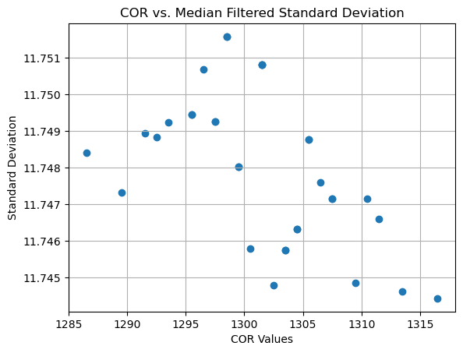
Point Estimation from Zoomed Plot
dSD/dCOR > 0
dSD/dCOR < 0
COR = 1300.5
COR = 1300.5
?
Manually Calculated COR: 1301.5

Slide 9
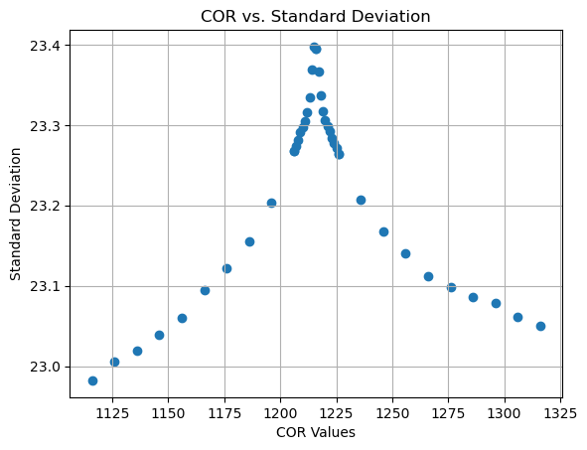
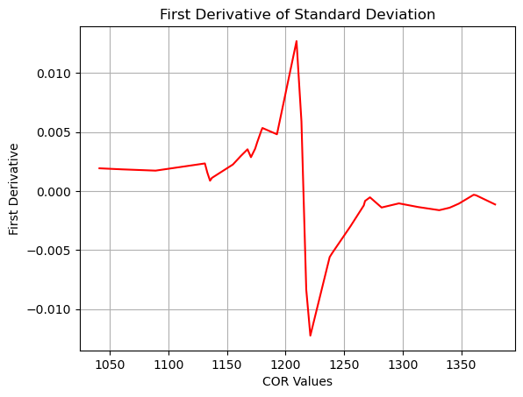
First Derivative
dy/dx > 0
dy/dx < 0

Slide 10
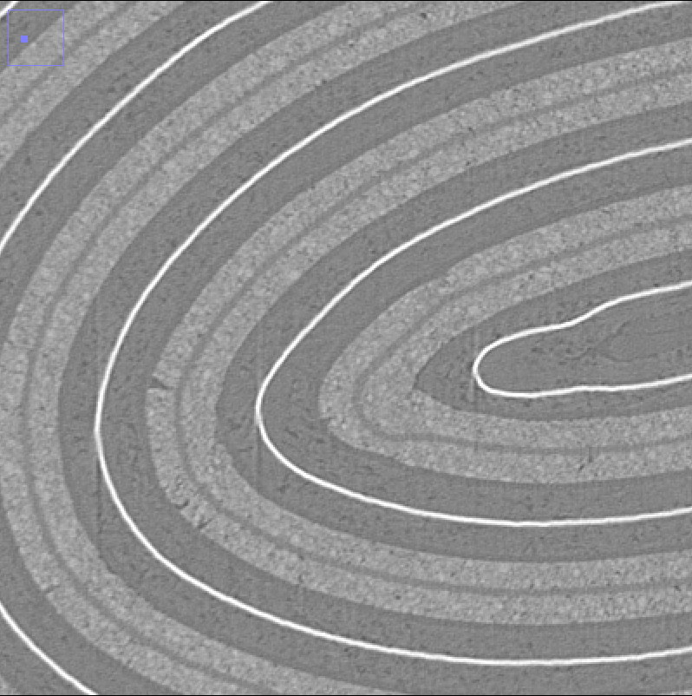
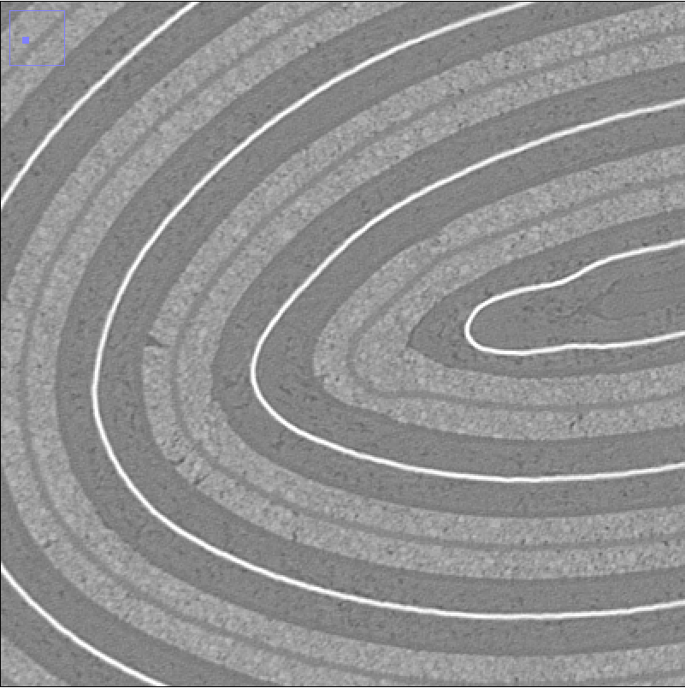
Comparison of Calculated COR
COR = 1300.5
COR = 1301.5

Slide 11
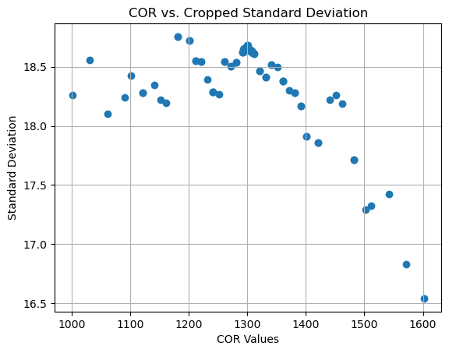
Cropping the Tiff (200px from Center)

Slide 12
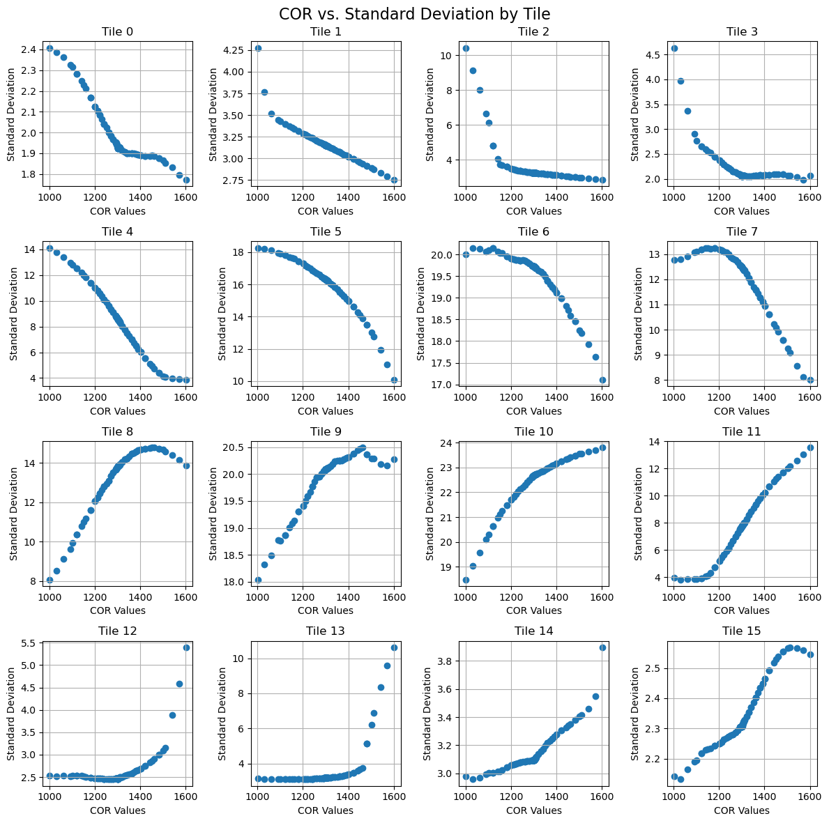
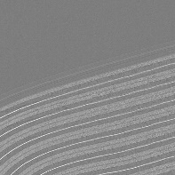
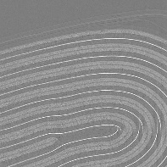
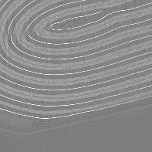
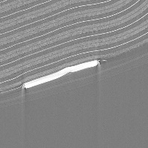
Observing the Tile Pattern

Slide 13
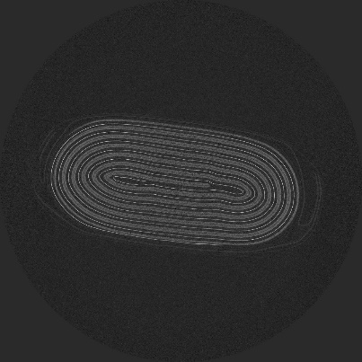
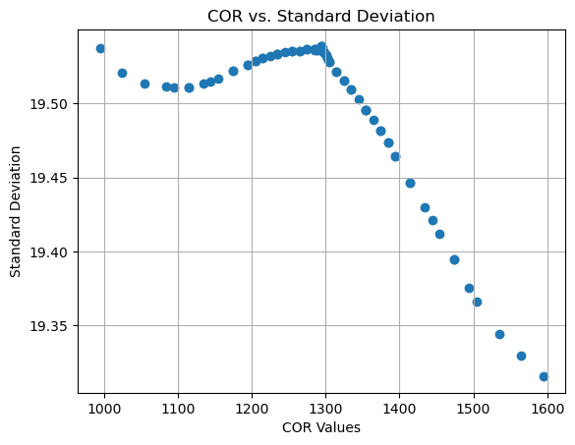
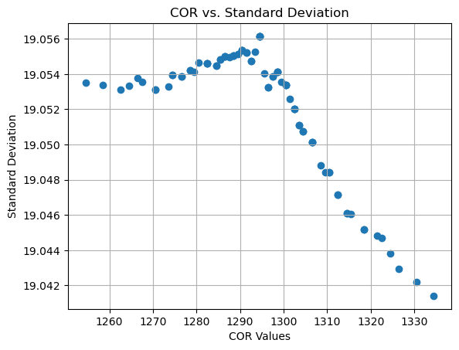
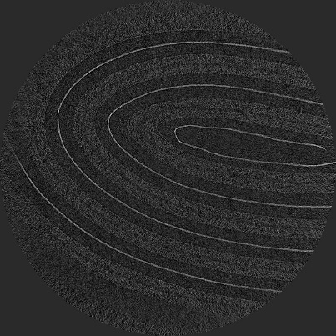
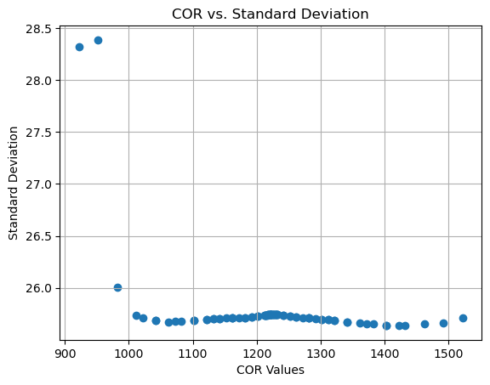
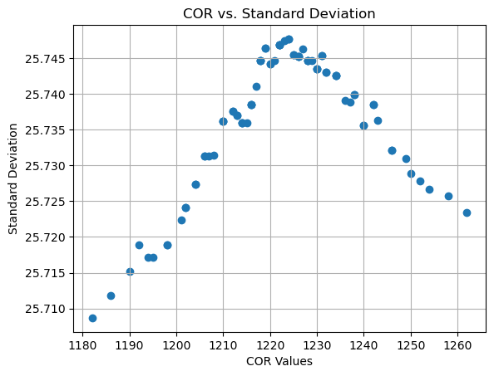
Curve Pattern Testing on Samples
C200
5_230110_1358_00001
C200
10_230110_1538_00001

Slide 14
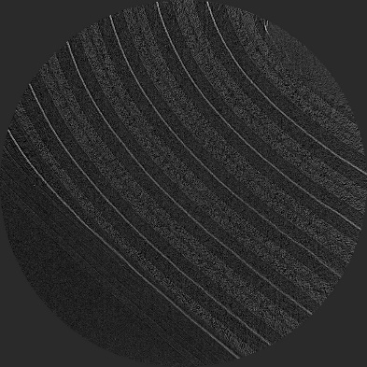
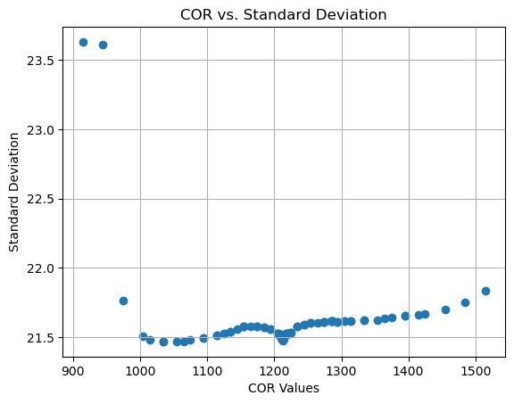
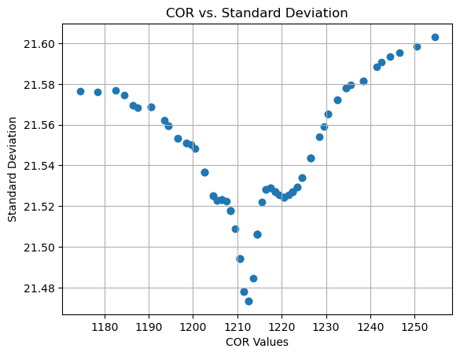
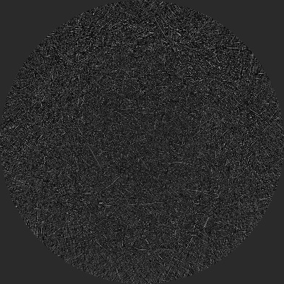
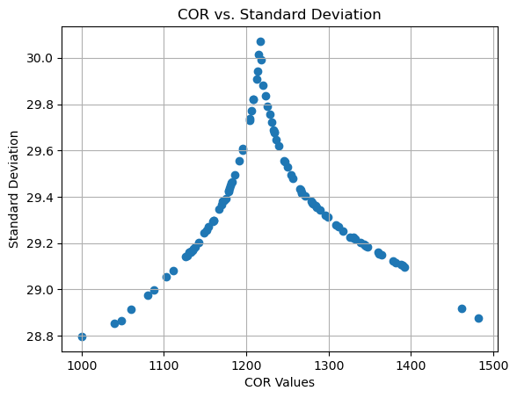
Curve Pattern Testing on Samples
C200
13_230110_1704_00001
Si100_Operando
6_230606_1426_00001

Slide 15
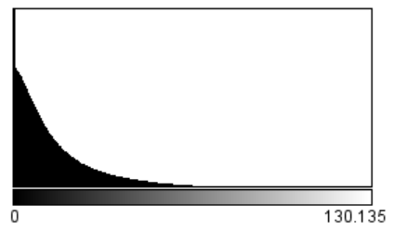
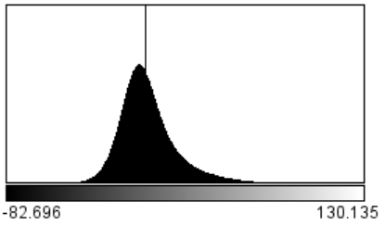
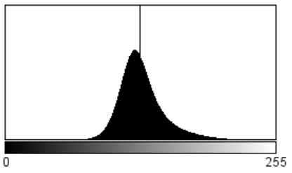
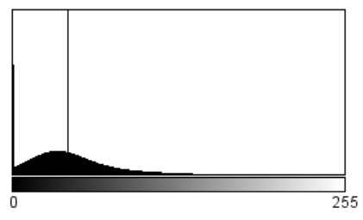
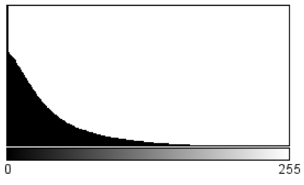
Intensity Clipping
32Bits 0 to Infinity
Clipping
8Bits -100 to 100
32bit Reconstruction
8Bits -20 to 100
8Bits 0 to 100

Slide 16
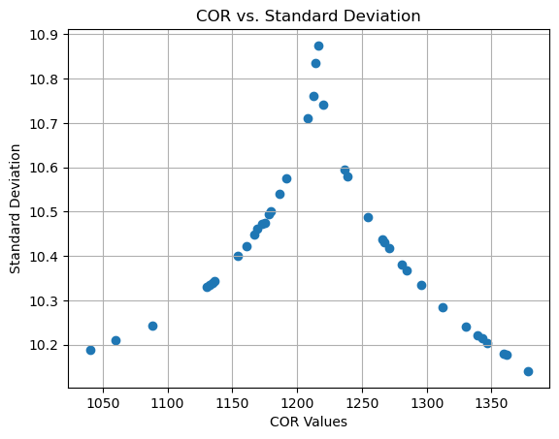
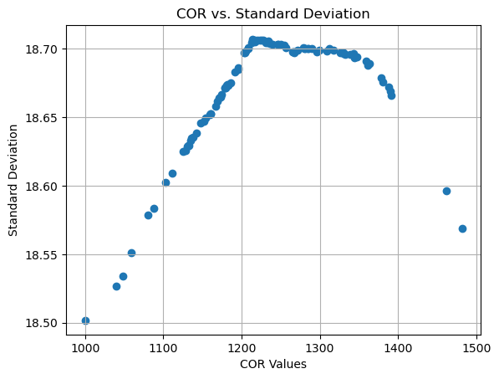
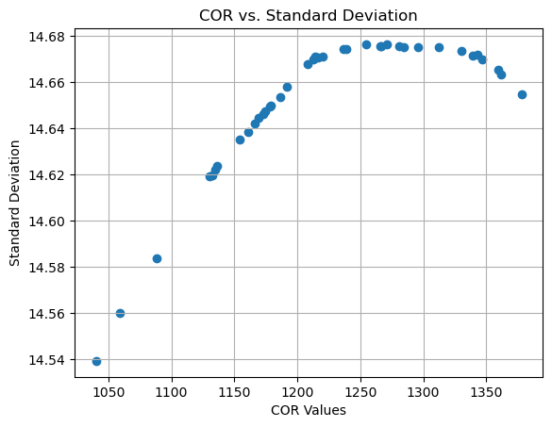
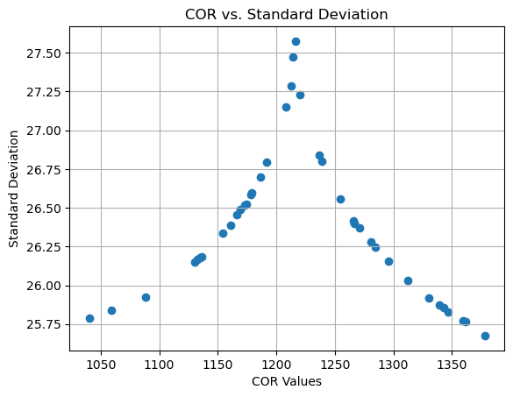
Reconstructed Clipped Plot
32Bits 0 to Infinity
32bit Reconstruction
Clipping
8Bits -100 to 100
8Bits -20 to 100
8Bits 0 to 100

Slide 17
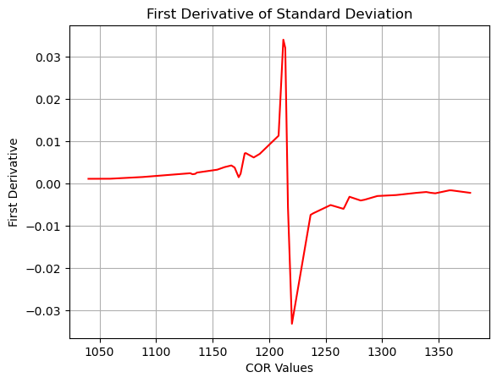
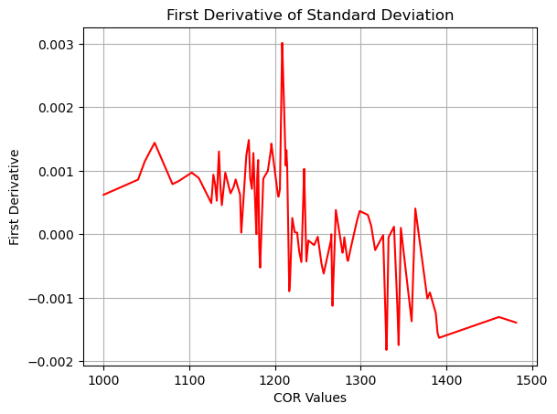
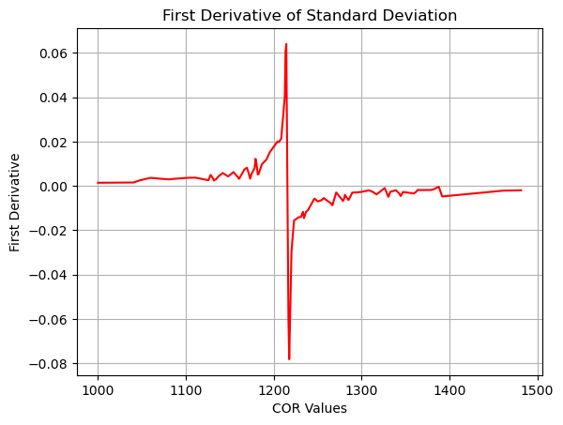
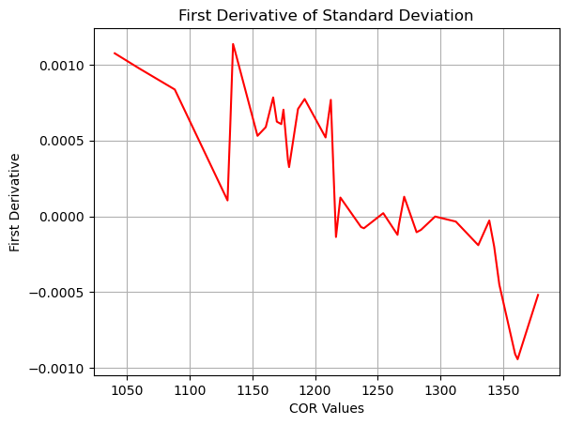
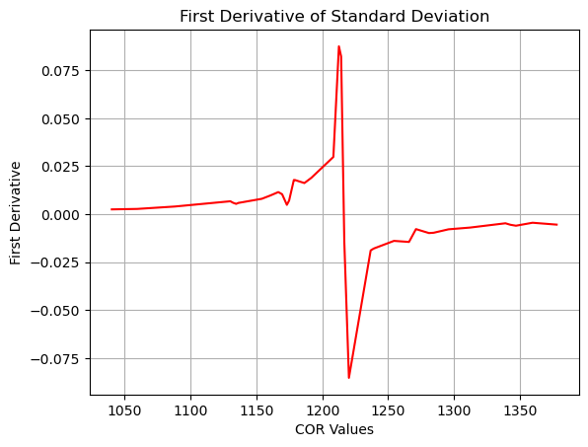
Intensity Clipping Impact
32Bits 0 to Infinity
32bit Reconstruction
Clipping
8Bits -100 to 100
8Bits -20 to 100
8Bits 0 to 100

Slide 18
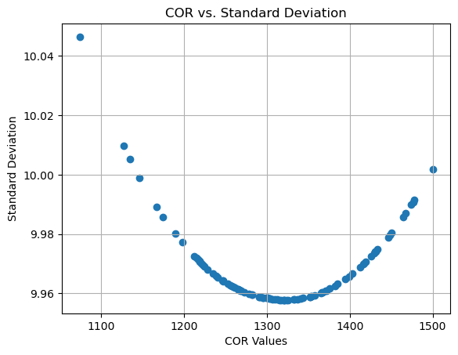
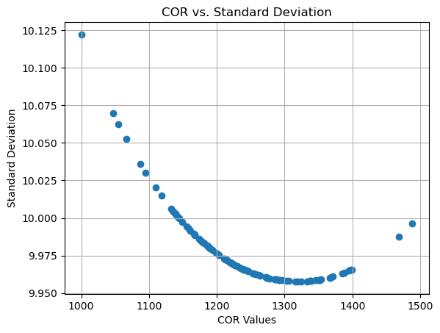
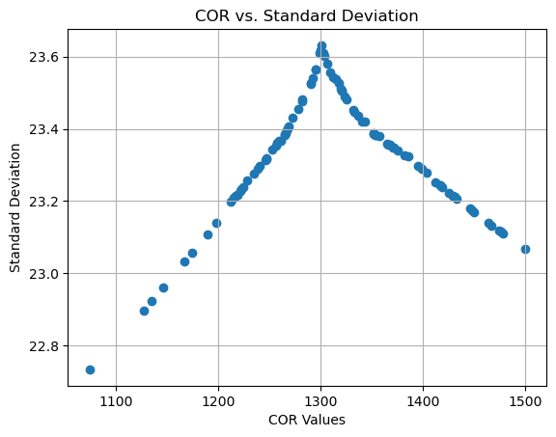
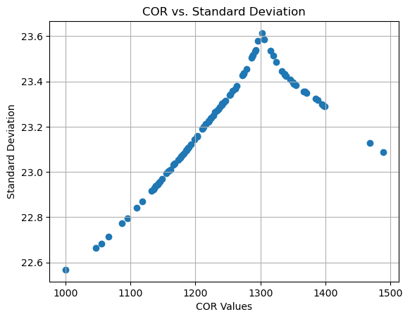


Testing on Other Samples
C200
2_230110_1200_00001
C200
13_230110_1704_00001
32Bit Unclipped
8Bit 0 to 100
32Bit 0 to Infinity

Slide 19

Observing the Tile Pattern (32Bit 0 to Infinity)

Slide 20
Conclusion
We observe a pattern for std image vs. COR .
To use this pattern we need to generalize for all CTs. How do we do that ?
Clipping the negative values

Slide 21

Comparison of Calculated COR
COR = 1300.5
Without Clipping
COR = 1301.5
Manually
COR = 1301.6
With Clipping

